Slide 1
OOP with PHP

Slide 2
Objectives
Object Oriented Concepts
Class & Object in OOP
Constructors
OOP features

Slide 3
Introduction to OOP
Object-oriented programming is a style of coding that allows developers to group similar tasks into classes.
Class
This is a programmer-defined data type, which includes local functions as well as local data. You can think of a class as a template for making many instances of the same kind (or class) of object.
Object
An individual instance of the data structure defined by a class. You define a class once and then make many objects that belong to it. Objects are also known as instance.
Member Variable
These are the variables defined inside a class. This data will be invisible to the outside of the class and can be accessed via member functions. These variables are called attribute of the object once an object is created.

Slide 4
Introduction to OOP
Member function
These are the function defined inside a class and are used to access object data.
Parent class
A class that is inherited from by another class. This is also called a base class or super class.
Child Class
A class that inherits from another class. This is also called a subclass or derived class.
Constructor
Refers to a special type of function which will be called automatically whenever there is an object formation from a class.
Destructor
Refers to a special type of function which will be called automatically whenever an object is deleted or goes out of scope.

Slide 5
OOP Features
Inheritance
When a class is defined by inheriting existing function of a parent class then it is called inheritance. Here child class will inherit all or few member functions and variables of a parent class.
Polymorphism
This is an object oriented concept where same function can be used for different purposes. For example function name will remain same but it make take different number of arguments and can do different task.
Overloading
a type of polymorphism in which some or all of operators have different implementations depending on the types of their arguments. Similarly functions can also be overloaded with different implementation.
Data Abstraction
Any representation of data in which the implementation details are hidden (abstracted).
Encapsulation
refers to a concept where we encapsulate all the data and member functions together to form an object.

Slide 6
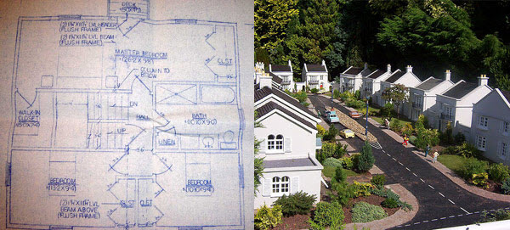
Class & Object
A class, for example, is like a blueprint for a house. It defines the shape of the house on paper, with relationships between the different parts of the house clearly defined and planned out, even though the house doesn't exist.
An object, then, is like the actual house built according to that blueprint. The data stored in the object is like the wood, wires, and concrete that compose the house: without being assembled according to the blueprint, it's just a pile of stuff. However, when it all comes together, it becomes an organized, useful house.

Slide 7
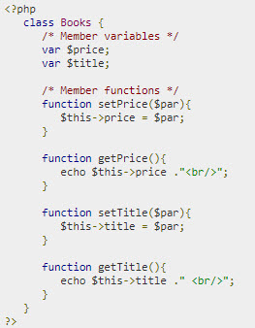
Defining class
The special form class, followed by the name of the class that you want to define.
A set of braces enclosing any number of variable declarations and function definitions.
Variable declarations start with the special form var, which is followed by a conventional $ variable name; they may also have an initial assignment to a constant value.
Function definitions look much like standalone PHP functions but are local to the class and will be used to set and access object data.
The variable $this is a special variable and it refers to the same object ie. itself.

Slide 8

Creating Objects in PHP
Once you defined your class, then you can create as many objects as you like of that class type. Following is an example of how to create object using new operator.
Example:
Here we have created three objects and these objects are independent of each other and they will have their existence separately.

Slide 9
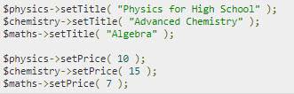
Calling Member Functions
After creating your objects, you will be able to call member functions related to that object. One member function will be able to process member variable of related object only.
Example:

Slide 10

Constructor
Constructor Functions are special type of functions which are called automatically whenever an object is created. So we take full advantage of this behaviour, by initializing many things through constructor functions.
PHP provides a special function called __construct() to define a constructor. You can pass as many as arguments you like into the constructor function.
Example:

Slide 11
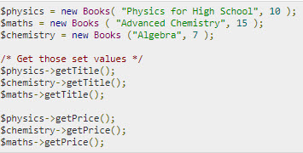
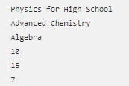
Constructor
Example:
Output:

Slide 12
Destructor
Like a constructor function you can define a destructor function using function __destruct().
You can release all the resources within a destructor.

Slide 13
Demo
Teacher demo code about defining class and creating object in PHP

Slide 14

Inheritance
PHP class definitions can optionally inherit from a parent class definition by using the extends clause.
Syntax:
The effect of inheritance is that the child class (or subclass or derived class) has the following characteristics:
Automatically has all the member variable declarations of the parent class.
Automatically has all the same member functions as the parent, which (by default) will work the same way as those functions do in the parent.

Slide 15
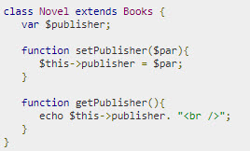
Example

Slide 16
Public Members
Unless you specify otherwise, properties and methods of a class are public. Public member may be accessed in three possible situations:
From outside the class in which it is declared
From within the class in which it is declared
From within another class that implements the class in which it is declared
If you wish to limit the accessibility of the members of a class then you define class members as private or protected.

Slide 17
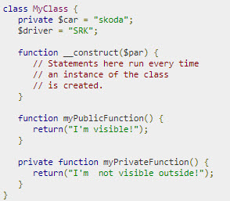
Private members
By designating a member private, you limit its accessibility to the class in which it is declared.
The private member cannot be referred to from classes that inherit the class in which it is declared and cannot be accessed from outside the class.
A class member can be made private by using private keyword in front of the member.
Example:

Slide 18
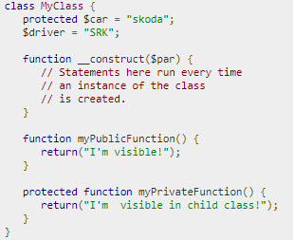
Protected members
A protected property or method is accessible in the class in which it is declared, as well as in classes that extend that class.
Protected members are not available outside of those two kinds of classes.
A class member can be made protected by using protected keyword in front of the member.
Example:

Slide 19


Interfaces
Interfaces are defined to provide a common function names to the implementers.
Different implementors can implement those interfaces according to their requirements. You can say, interfaces are skeletons which are implemented by developers.
Example:
Implement interface:

Slide 20

Abstract Classes
An abstract class is one that cannot be instantiated, only inherited. You declare an abstract class with the keyword abstract.
When inheriting from an abstract class, all methods marked abstract in the parent's class declaration must be defined by the child; additionally, these methods must be defined with the same visibility.
Note that function definitions inside an abstract class must also be preceded by the keyword abstract. It is not legal to have abstract function definitions inside a non-abstract class.
Example:

Slide 21
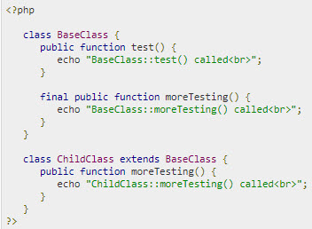
Final Keyword
Final keyword prevents child classes from overriding a method by prefixing the definition with final.
If the class itself is being defined final then it cannot be extended.
Following example results in Fatal error: Cannot override final method BaseClass::moreTesting()

Slide 22
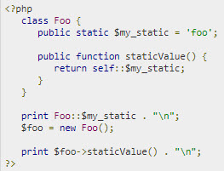
Static Keyword
Declaring class members or methods as static makes them accessible without needing an instantiation of the class.
A member declared as static can not be accessed with an instantiated class object (though a static method can).
Example:

Slide 23
Demo
Teacher demo code about OOP features in PHP

Slide 24
Summary
Object Oriented Concepts
Class & Object in OOP
Constructors
OOP features

